Slide 1


INTERACTIVE SALES DASHBOARD
USING POWER BI
Objective:
To design an interactive and insightful dashboard that enables business stakeholders to monitor key performance indicators (KPIs) such as Total Sales, Profit, and Profit Margin. The dashboard helps drive data-informed decisions by presenting trends, segment performance, and product profitability in a user-friendly visual format.

Slide 2
DATASET DESCRIPTION
Dataset Used: Sample - Superstore (Retail Sales Data)
Source: Kaggle
Time Period: 2011 to 2014
Records: Over 10,000 sales transactions
Key Fields:
Order Date, Ship Date
Sales, Profit, Discount, Quantity
Order ID, Customer Name, Product Name
Segment, Region, State, City
Category, Sub-Category
The dataset captures retail orders with details on customers, products, geography, and financial metrics.

Slide 3
KPI’S CHOSEN
1. Total Sales-
-Shows the total revenue generated through customer orders. It indicates business
size and growth.
2. Total Profit-
-Net earnings after accounting for costs and discounts. Crucial for understanding business sustainability.
3. Total Orders-
-Reflects transaction volume, helping analyze demand and order frequency.
4. Average Profit Margin-
-Shows profitability efficiency. High margin = more profit per unit of sales.
These KPIs provide a comprehensive overview of financial health, operational efficiency, and customer activity.

Slide 4
DASHBOARD
Key Visuals in the Dashboard:
KPI Cards: Total Sales (13M), Profit (1.47M), Orders (25K), Avg. Profit Margin (11.61%)
Line Chart: Monthly Sales & Profit trend
Pie Chart: Segment-wise sales distribution
Bar Chart: Profit Margin by Region
Map: Overall sales by State
Scatter Plot: Sales vs Profit (by Sub-Category)
Line Chart: Avg. Profit Margin by Month
These visuals provide layered insights and are connected using slicers and filters for interactivity.

Slide 5
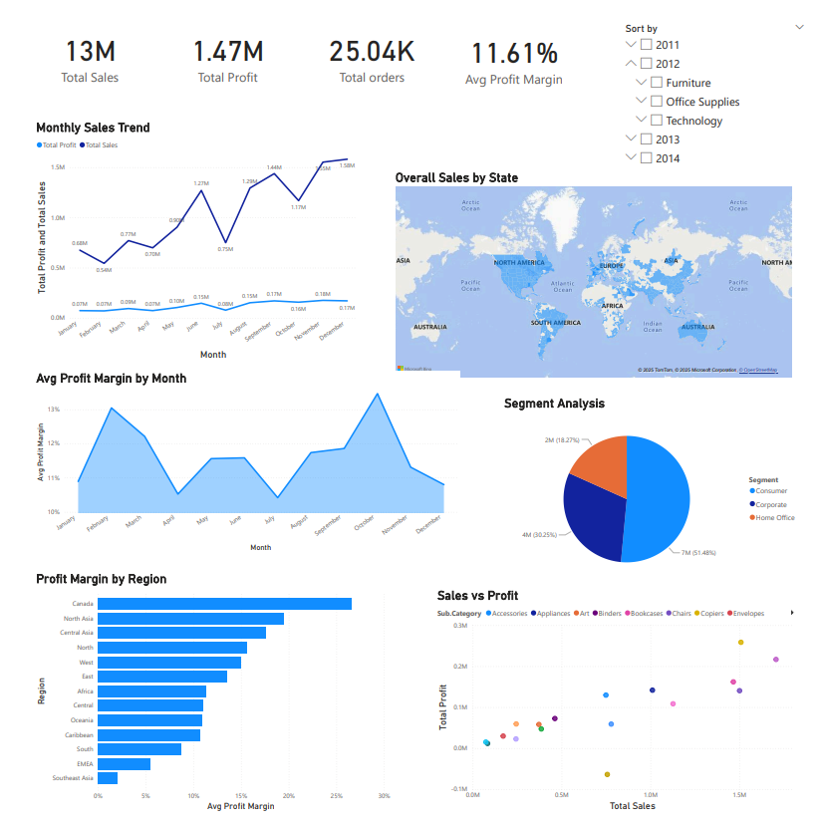

Slide 6
1. Monthly Sales & Profit Trend (Line Chart) -
This line chart visualizes monthly trends in Total Sales and Profit over the course of the year. It highlights peak sales months such as March, July, and December, helping identify seasonal patterns. The dual-line format allows easy comparison between revenue and profitability, assisting in planning marketing and inventory cycles.
2. Segment Analysis (Pie Chart) -
The segment-wise pie chart shows the distribution of total sales among Consumer (51.48%), Corporate (30.25%), and Home Office (18.27%) segments. This helps assess which customer groups contribute the most to sales, enabling targeted marketing and customer engagement strategies.
3. Profit Margin by Region (Bar Chart) -
This bar chart compares the average profit margin across different regions like Central, West, North, Southeast Asia, and Africa. It reveals that some regions like Central and West have higher margins, while others perform below average, helping business leaders decide where to expand or improve cost-efficiency.

Slide 7
4. Overall Sales by State (Map Visual) -
The geographic map displays state-wise sales performance, with darker shades indicating higher revenue contribution. It allows quick regional insights and helps identify high-performing areas like California and New York, and regions that may need targeted sales strategies or resource allocation.
5. Sales vs Profit Scatter Plot (Sub-Category View) -
This scatter plot shows the relationship between Total Sales and Total Profit for each product sub-category. It clearly separates high-profit, high-sales categories like Copiers and Phones, and highlights poor performers such as Tables and Bookcases, guiding product-level strategic decisions.
6. Avg. Profit Margin by Month (Line Chart) -
This line chart tracks the average profit margin month-over-month, showing performance fluctuations. Notable high-margin months include February and May, while March and July, despite high sales, reflect lower margins. This helps evaluate discount strategies or seasonal cost pressures.

Slide 8
KEY INSIGHTS
The business generated over 13 million in sales and 1.47 million in profit across 25,000+ orders.
Consumer segment is the highest contributor to sales (51.48%), followed by Corporate (30.25%).
West and Central regions have the highest average profit margins; Southeast Asia and Africa are less profitable.
Sub-categories like Copiers and Chairs are highly profitable; others like Tables and Bookcases show poor or negative margins.
Sales peak in March, July, and December, indicating strong seasonal influence on performance.

Slide 9
RECOMMENDATIONS
To Focus more on Consumer and Corporate segments with targeted promotions or loyalty programs.
Increase investment in high-margin sub-categories like Copiers and Chairs.
Re-evaluate pricing and discount strategy for underperforming product lines (e.g., Tables).
Expand operations in high-performing regions (e.g., West) and reassess strategy in underperforming areas.
Use monthly trend analysis to plan peak-season inventory and marketing in March, July, and December

Slide 10
THANK YOU

